Slide 1

Social Construction Theory
WST3015: Interdisciplinary Perspectives in Women’s Studies

Slide 2

WHAT YEAR IS IT?

Slide 3
What is social constructionism?
A theory of knowledge that holds that traits normally thought to be undisputable and biological—such as gender, race, class, ability, and sexuality—are products of human definition and interpretation shaped by cultural and historical contexts.

Slide 4
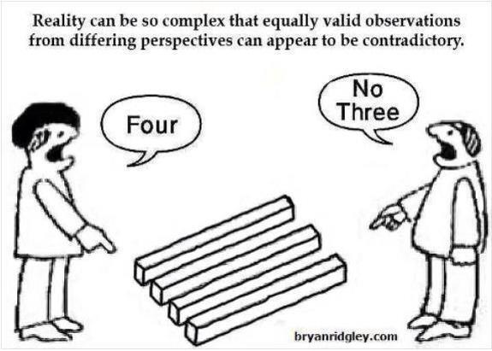
What is real what is true?

Slide 5


Is the woman stuck in concrete? Or is she standing ALONGSIDE a wall?
IS THE DRESS WHITE AND GOLD?
OR IS IT BLUE AND BLACK?

Slide 6
Social constructionism highlights the ways in which cultural categories—like “men,” “women,” “black,” “white”—are concepts created, changed, and reproduced through historical processes.
This is not to say that bodily variation among individuals does not exist, but that we construct categories based on certain bodily features, we attach meanings to these categories, and then we place people into the categories by considering their bodies or bodily aspects.
Example: The ”one drop” rule

Slide 7

What does “Race” Mean? What race are these women?

Slide 8
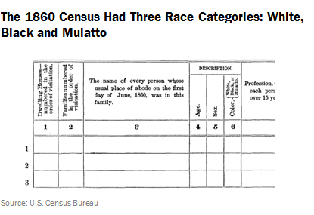
1860 Census

Slide 9
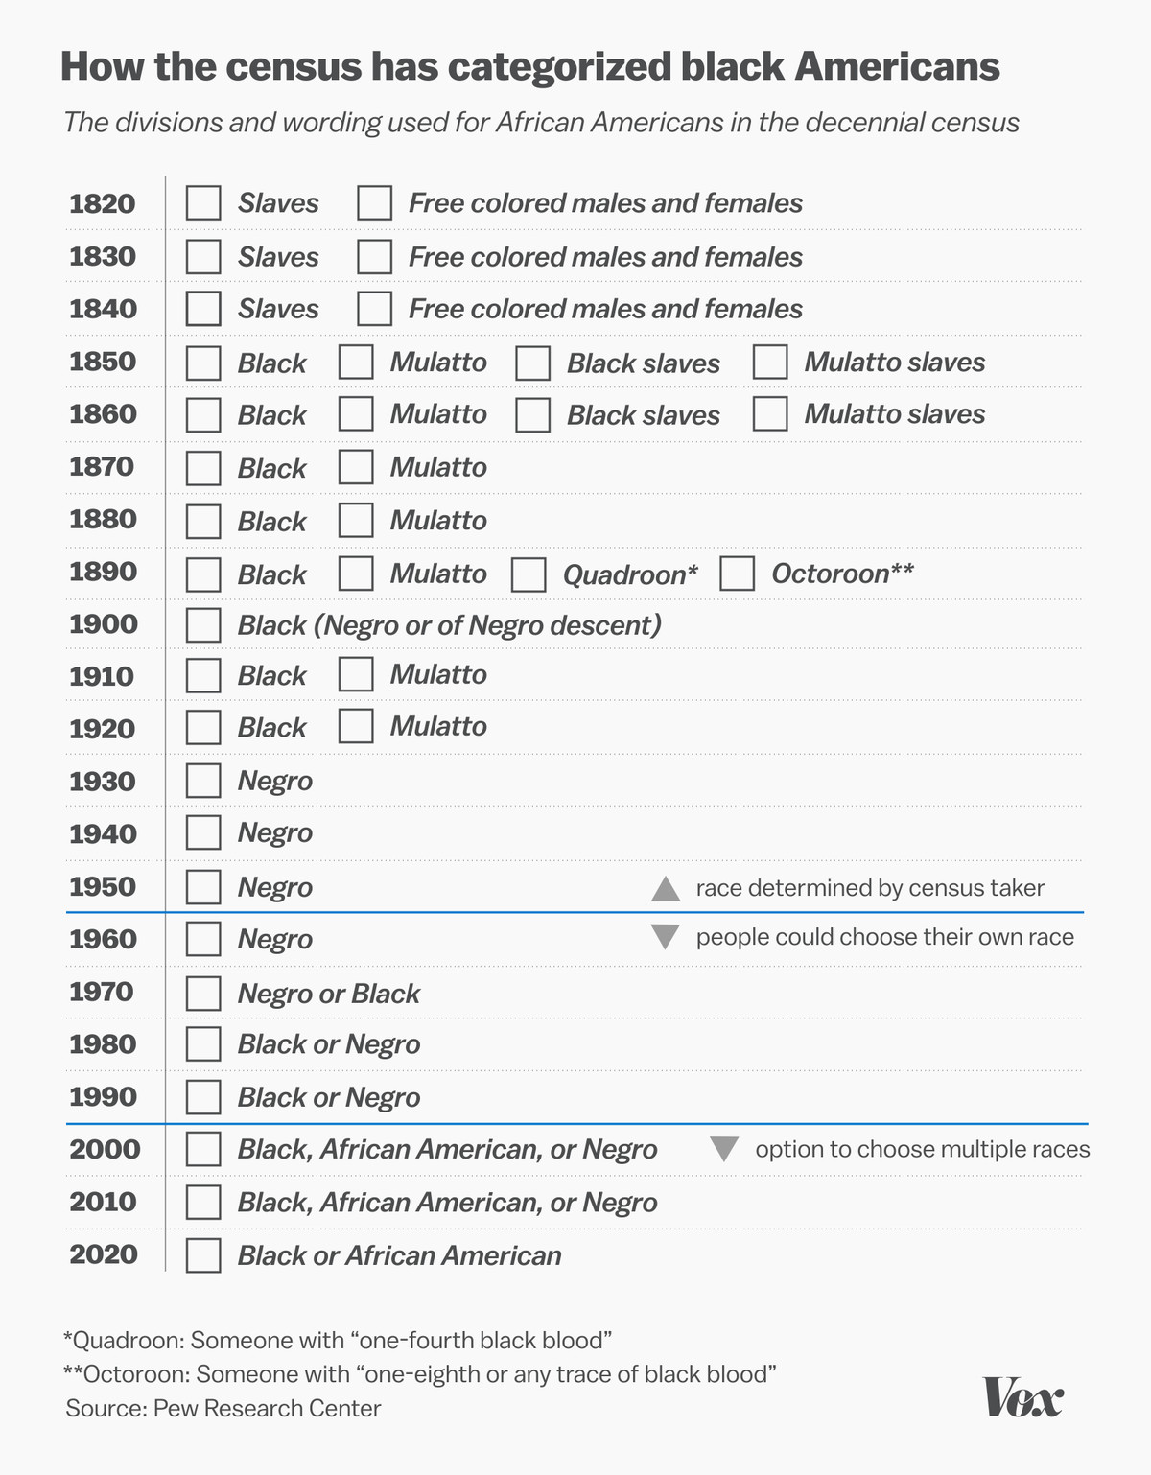
Race is a social construct:

Slide 10
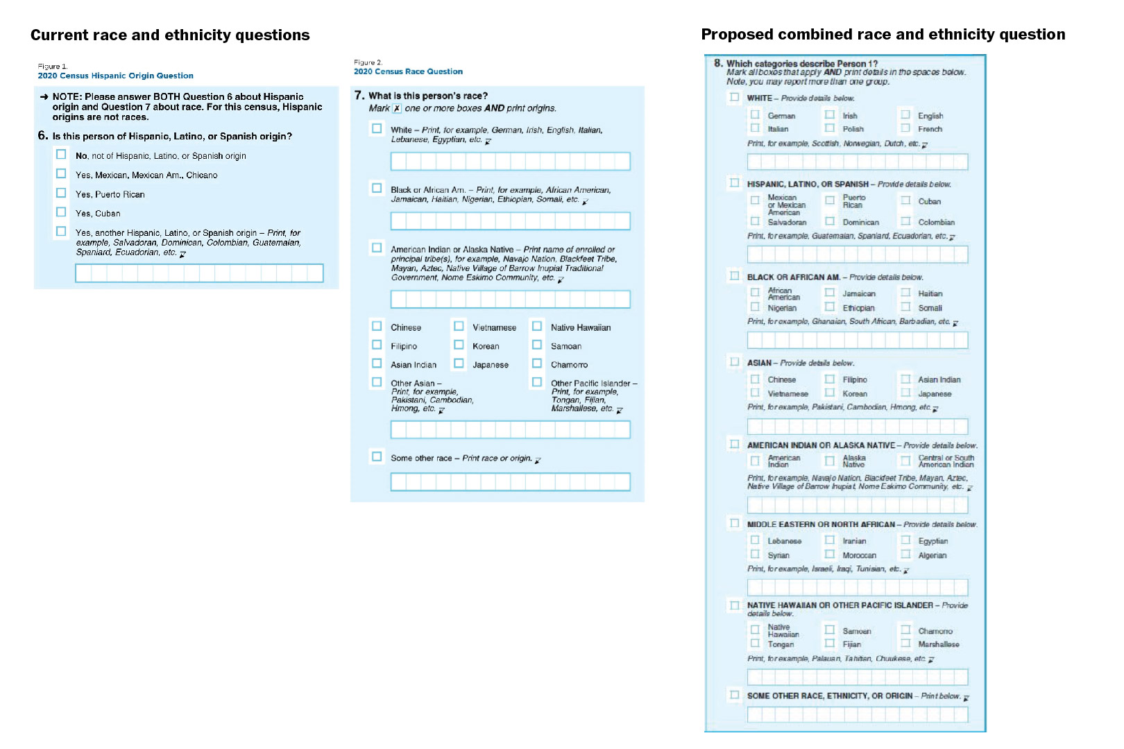
Proposed Changes Reflect current constructs.

Slide 11
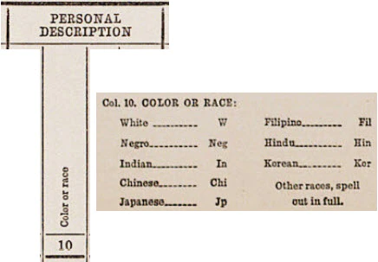
Meanings of Race Shift over time
1940 Census:

Slide 12
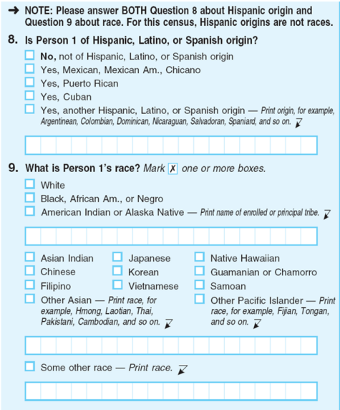
2010 Census

Slide 13
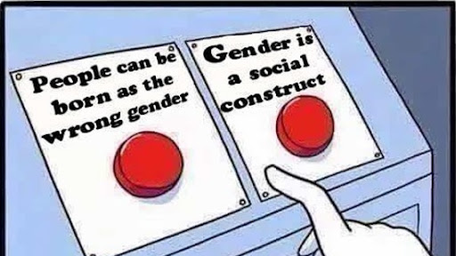
How does this relate to gender studies?

Slide 14
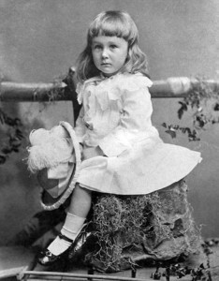
a June 1918 article from the trade publication Earnshaw's Infants' Department said, “The generally accepted rule is pink for the boys, and blue for the girls

Slide 15
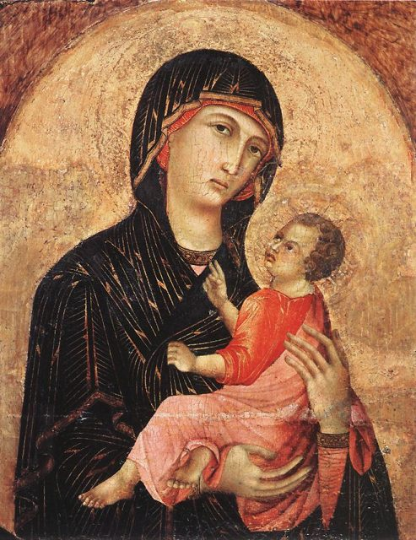
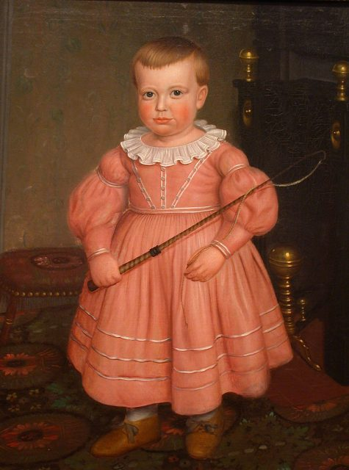

Slide 16

Yankee Doodle went to town riding on a pony.
He stuck a feather in his cap and called it macaroni.

Slide 17
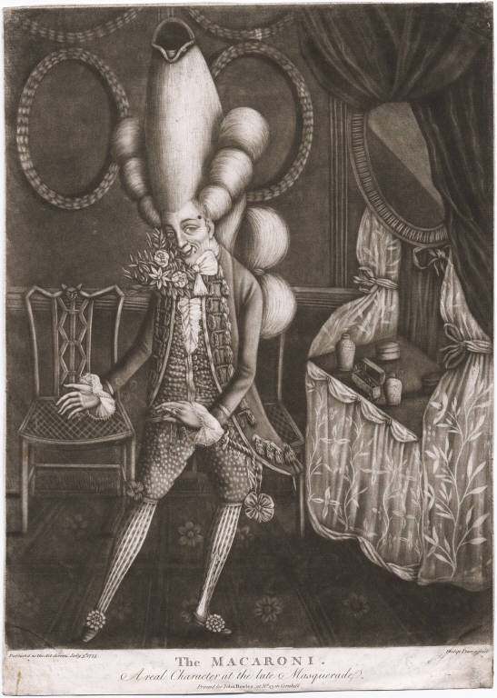

Slide 18
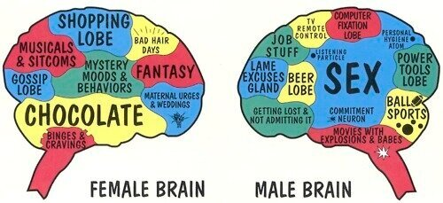
Essentialism
Essentialism is the idea that the characteristics of persons or groups are significantly influenced by biological factors and are therefore largely similar in all human cultures and historical periods.

Slide 19
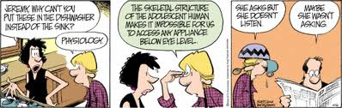
Biological determinism
Can be defined as a general theory, which holds that a group’s biological or genetic makeup shapes its social, political, and economic destiny (Subramaniam 2014). For example, “sex” is typically thought to be a biological “fact,” where bodies are classified into two categories, male and female.

Slide 20
Theories behind social constructionism
Critical Theory
  A challenge of the dominant discourse typically spearheaded by marginalized groups (feminists, BIPOC, differently abled communities, etc.)
  Foucault and a discussion of the ”docile body”
Literary Theory
  Posits language as the driving factor in the construction of categories. Every form of description we use asserts its own reality over what we want to describe.
Social Theory
  Whatever scientists do will manifest out of the enclave they exist. The scientific observer is a part of a community and will use the traditions of that community to create that study. They operate on a similar methodology, a similar language, how to write about it, how to use statistics.

